Slide 1
S&T Connect & Instructors
Dr. Wes Lewis, Assistant Vice Provost Undergraduate Education

Slide 2
Overview
Purpose of S&T Connect
Instructors Tools
Enrollment Verification Survey & Week-5 Survey

Slide 3
Purpose of S&T Connect
Instructors
Student
Campus Support Services
S&T Connect provides an integrated connection between instructors, students, and campus support services.

Slide 4
Instructors Tools

Slide 5
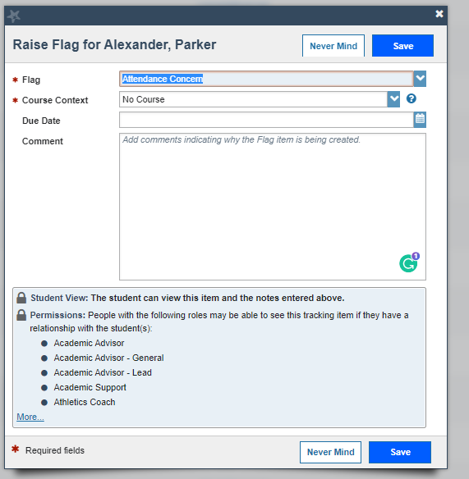
Flag
Allows instructors to raise concerns about a student.
Behavioral
Attendance Concerns
Grades/Assignments
Poor Class Performance
Other
Students receive notice of flag except for (Behavioral).

Slide 6
Flag | Response
Attendance Concern | Student receives notification from instructor
Attendance Warning | Student and Academic Advisor receive email
Behavioral Concern | Student Support & Community Standards Receive Notification and outreach to student (Student does not get notified)
General Concern-Student | Student receives notification from instructor
In Danger of Failing | Student & Academic Advisor Receive Notification. Advisor typically follow up.
Low Quiz/Test Score | Student receives notification from instructor
Missed Assignment | Student receives notification from instructor
Poor Class Performance | Student receives notification from instructor

Slide 7
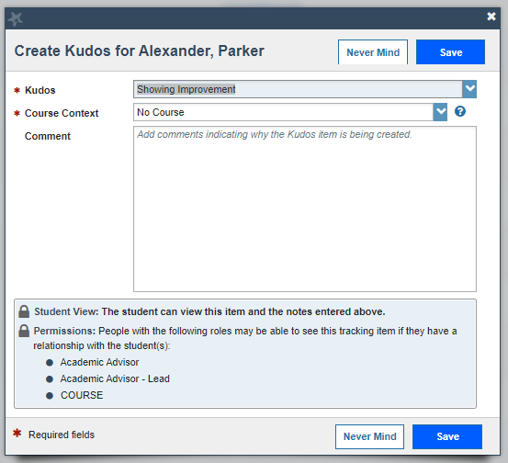
Kudos
Allows students to receive positive feedback for improvements.
Outstanding Academic Performance
Keep up the Good Work
Showing Improvement
Recommend to become an academic tutor

Slide 8
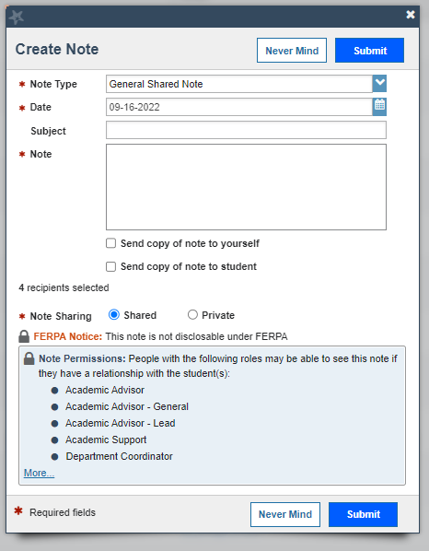
Notes
Allows for communication between instructor and academic advisor.
Creates documentation for conversations with students concerning courses or advisement.

Slide 9
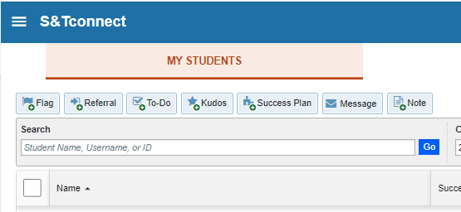
Other Items
Referrals
Connects students with service providers (e.g., tutoring)
Message
Allows instructors to email students or entire course.

Slide 10
Progress Survey
Used for course verification survey by the Registrar’s Office and Undergraduate Education
Ask instructors to verify certain information for students within their course by raising a flag.
Flag triggers intervention from campus service provider

Slide 11
Progress Surveys:
Week-5 and Enrollment Verification

Slide 12
Progress Survey

Slide 13
Enrollment Verification Survey
Purpose: To verify students’ enrollment in courses per Department of Education regulations.
Time Frame: Friday, Aug. 30 to Tuesday, Sept. 10.
Process: Mark students who have not attended or stopped attending class. Students are notified and the Registrar’s Office will remove them from the course within 2 business days.

Slide 14
Week-5 Academic Alert Survey
Purpose: To identify students who are struggling academically and connect them with appropriate campus support services.
Time Frame: Wednesday, Sept. 11 to Sunday, Sept. 22.
Process: Mark students who have a ‘D’ or lower in the course, accompanied by concerns regarding their potential to improve. Students are notified of the flag, academic advisors will follow up, and other student support services will connect as well.

Slide 15
S&T Connect
For additional trainings or 1-1 consultations
Contact: Dr. Wes Lewis at 573.341.7600 wesley.lewis@mst.edu

